Slide 1
Higher education in Afghanistan: current situation
Said Reza Kazemi, Dr. phil.
Visiting researcher, Institut für Ethnologie, Ruprecht-Karls-Universität Heidelberg
Session “Researchers at risk: European solidarity with Afghanistan and Ukraine”
Event “Inspireurope Regional Outreach Workshop”
Thessaloniki, Greece and online
31 March 2021

Slide 2
Outline
What has happened to higher education in Afghanistan since the Taleban takeover in mid-August 2021?
Establishing a system of controlling higher education
Instructing a new higher education policy
Repercussions
Concluding remarks

Slide 3
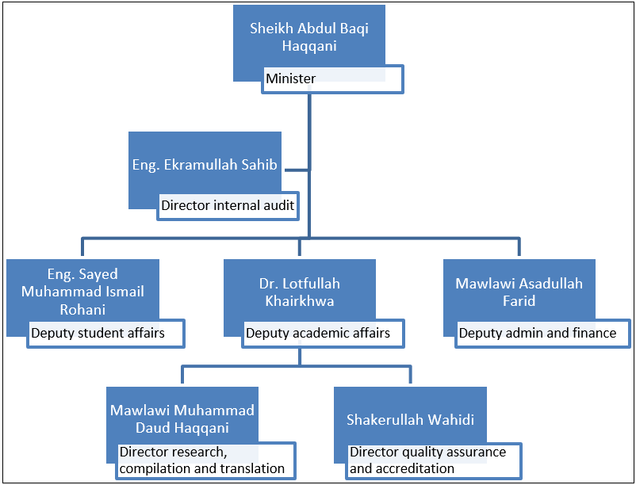
1. A system of control
a) Taleban-run ministry of higher education
staffing key positions with own officials, members or sympathisers
appointees: all men, mainly a background of fighting the previous government and/or studying Islamic religious sciences particularly in Pakistan, mostly Pashtun in ethnicity, especially from eastern province of Nangarhar
ministry taken like a ‘spoil of war’
Key Taleban appointments for MoHE as of early March 2022, reproduced here as they are officially addressed in MoHE press releases. Source: data compiled by the presenter.

Slide 4
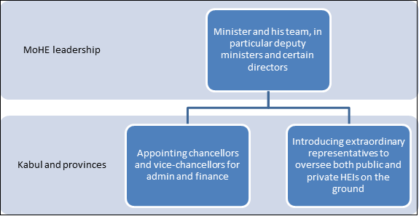
b) Extending control
new chancellors and vice-chancellors, especially for admin and finance
“extraordinary representatives” with broad powers to monitor and control administration, finance and even academic affairs
affecting most, if not all, public higher education institutions in capital Kabul and provinces
Two main ways in which the Taleban-run MoHE extends its control over higher education administration in the capital Kabul and the provinces.

Slide 5
2. A new higher education policy
Four instances of declaring a new policy

Slide 6
29 August 2021 introduction event: de facto minister Haqqani laid out a new policy
previous government followed “non-Muslims” in approach to science
Taleban would reinforce religious education and not distinguish between “religious sciences and natural sciences” as “they both belong to the religion and serve to strengthen an Islamic government”
“The ... people of Afghanistan will continue their higher education in the light of Sharia law in safety without being in a mixed male and female environment”
Taleban would “create a reasonable and Islamic curriculum that is in line with our Islamic, national and historical values and, on the other hand, be able to compete with other countries”
Key points
purifying ‘corruption’ in and ‘rectifying’ higher education from the period 2001-2021
focusing on religious education
ending coeducation
changing curriculum
Implementation followed in letting private and public higher education institutions resume work
separating females and males, plus dress codes
increasing religious education in curriculum
work on further changing curriculum underway

Slide 7
3. Repercussions throughout higher education ecosystem
Persecution
reported cases of abduction, assault, arrest and book ban of academics, but difficult to establish and attribute responsibility
Exodus of lecturers and students
large numbers fled or still fleeing Taleban rule
university-wide, encompassing the entire gamut of science taught in Afghanistan
Pay cut
top-down cut of lecturer salaries by around 40 per cent, on top of an economic collapse, inflation and currency devaluation
Shrinking international dimension
Taleban-run MoHE in contact with only a few countries (mainly Pakistan and, to a lesser extent, Turkey and Iran)
Fate of private higher education
given dramatic reduction in student numbers, many struggle to survive and, if this trend continues, become bankrupt and collapse

Slide 8
Concluding remarks
Officials put by Taleban in charge of MoHE and public HEIs not competent for their positions
Taleban shaping higher education policy after own ideology
Afghanistan’s higher education shrinking domestically and internationally
One could even ask: is there higher education any more in Afghanistan under Taleban’s second emirate?

